Slide 1
MPAcc Class of 2026
Remote Labs Orientation
Asher Curtis

Slide 2
Agenda
Foster Remote Labs
U-Drive, Git and Github
Analytics warm-up:
Ascombes_data exercise.
Homework_data challenge!
Wrap-up.

Slide 3
Foster Remote Labs
Objective: Introduce Foster remote labs for data analytics support:
We will navigate to the Foster Remote Labs (https://fprod-hcs.foster.uw.edu).
Locate/check U-Drive accessibility.
Use data delivery system with cmd, git, and github.
Undertake a guided analytics exercise with Alteryx and Tableau.

Slide 4
Why use remote labs?
The remote labs remove issues relating to downloading software onto your machine and allow us to work as a class in a common windows-based environment.

Slide 5
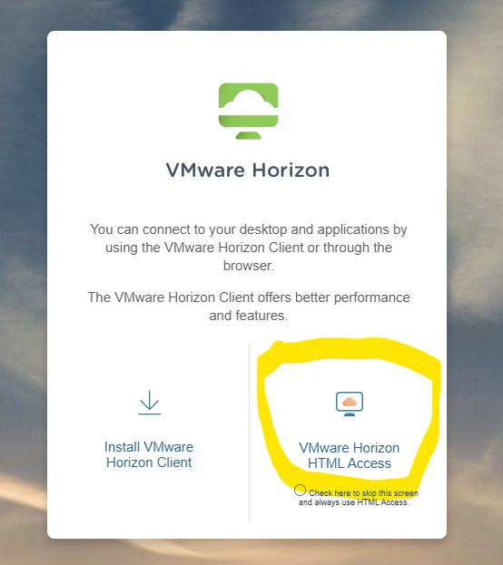
In the remote labs login, always use HTML Access
Login using UWNetID and password.

Slide 6
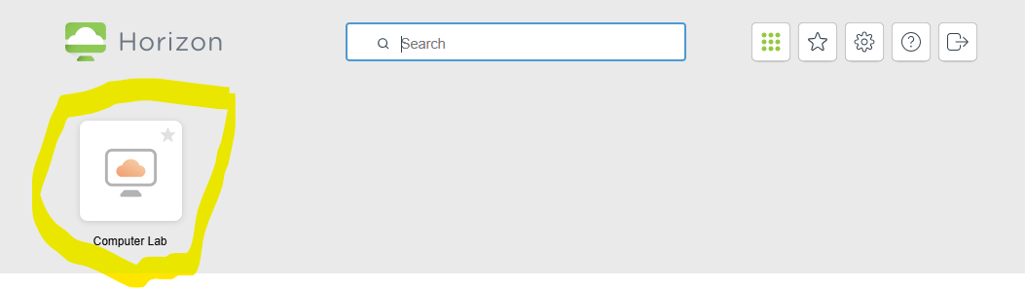
Choose Computer Lab
And the remote windows environment will load.

Slide 7
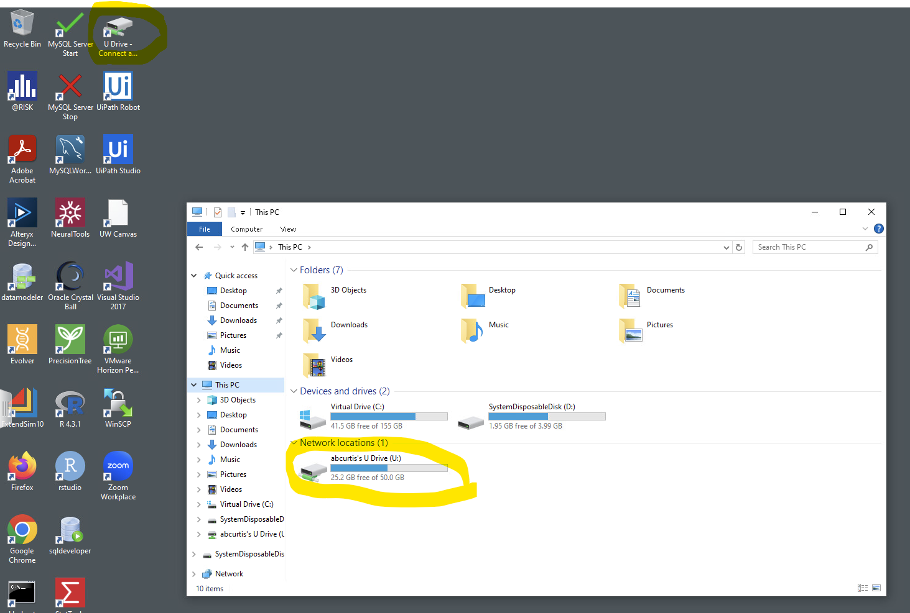
In This PC / File Explorer
U drive should be in network locations.
if not try using this script
“U Drive Connect and Open” on the desktop.

Slide 8
Next we will set up data delivery
Why use git and github?
Allows for flexibility in content delivery (in later classes) and helps with file management and removes most missing file issues.

Slide 9
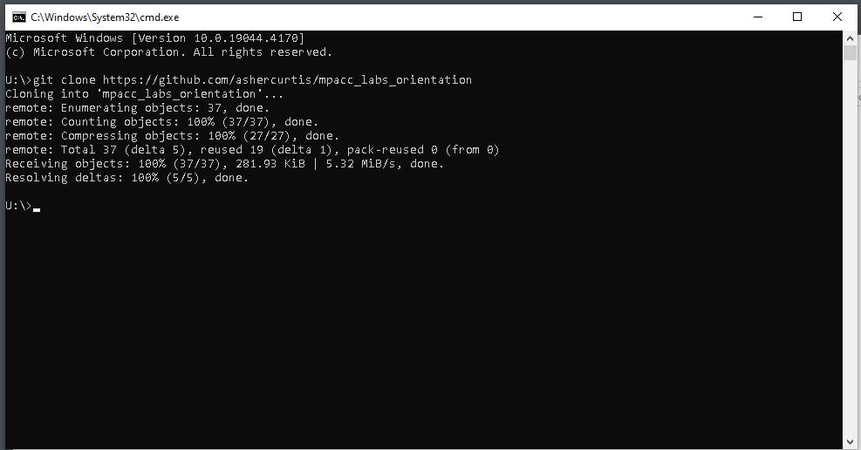
Cloning the repository
Click on address bar and type cmd
(and press Enter)
2. In the command window that pops up type:
git clone https://github.com/ashercurtis/mpacc_labs_orientation

Slide 10
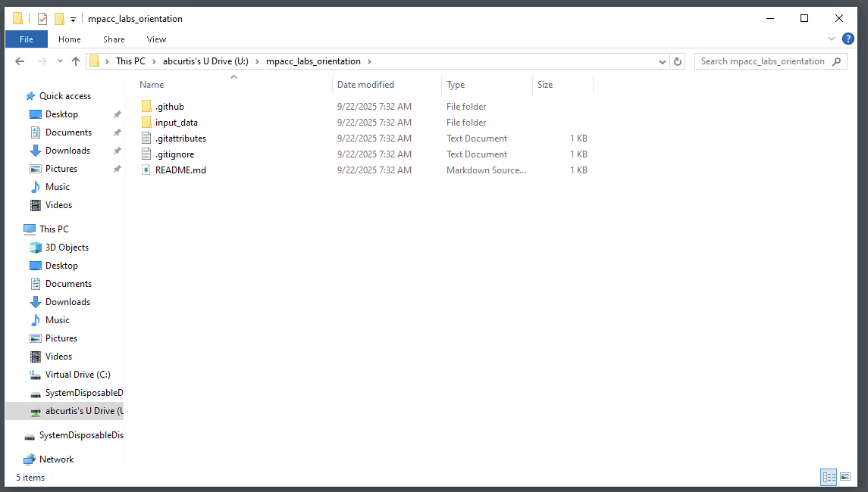
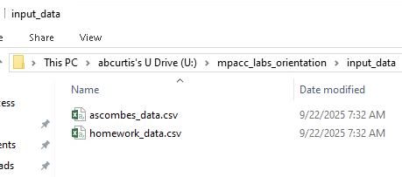
Navigate to the new folder “/mpacc_labs_orientation/”
Note that the data is stored in “/input_data/”

Slide 11
Congrats
That concludes our set-up.
Note that we will continue to use this data delivery method in future A521 and 522 (and 528) classes.

Slide 12
Agenda
Foster Remote Labs
U-Drive, Git and Github
Analytics warm-up:
Ascombes_data exercise.
Homework_data challenge!
Wrap-up.

Slide 13
Ascombes Quadrant Exercise
This exercise highlights why graphing or visualizing data is important.
Brief: We have data from four locations, the data includes a location number, pay per hour and hours worked. What do we learn from summary statistics versus graphing the data? Can we spot potential outliers for future analysis?

Slide 14
Homework Data Challenge!
This exercise is set up to reinforce the steps of the Ascombes data exercise.
Brief: Using a workflow like the one we just produced for Ascombes can you identify the homework eating culprit?
Hint: The field Dataset can be used to “Group By”

Slide 15
Thank you

